Slide 1
Progress Report
Progress Report
Team 1 – Remote Biomedical Monitoring
Group G12
28/10/2026 · Week 6
1
Notes:
1

Slide 2
Project Overview
 | W4 | W5 | W6 | W7 | W8 | W9 | W10 | W11 | W12 | W13 | W14
WP0 Mgmt
WP1 LoRaWAN |  |  |  | B1
WP2 BITalino
WP3 ECG proc. |  |  |  |  |  |  |  | B2
WP4 Platform |  |  |  |  |  |  |  |  | B3
WP5 Integration |  |  |  |  |  |  |  |  |  |  | D1/D2
Done
Planned
B1/B2/B3 = block deliverables, D1/D2 = final
Issues:
WP1: On schedule. First uplink working end-to-end (MKR WAN 1310 → TTIG → TTS). Downlink tests started, reception on the Arduino still to be verified.
WP2: Started ahead of plan (planned W7). BITalino acquiring ECG, ACC and LUX on a laptop; Raspberry Pi set up, but its Bluetooth link to BITalino still fails.
2
Notes:
2

Slide 3
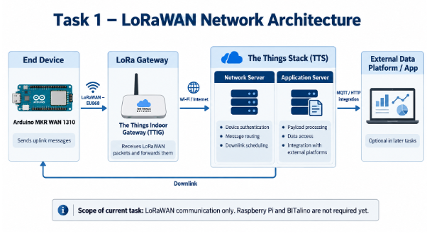
Achievements
✔ First uplink end-to-end (Task 3)
MKR WAN 1310 joined the network through the TTIG
Uplinks received in TTS Live Data (application pbe-team1-2026)
✔ Uplink part of B1 completed
Uplink tests done and logged; next step is the downlink
▶ Downlink tests started (Task 10)
Downlink scheduled from TTS; reception on the Arduino to be verified
✔ BITalino + OpenSignals (WP2)
BITalino-8C-30, Bluetooth classic (BT), Windows 11
ECG on A2 (10-bit), ACC on A5 and LUX on A6 (6-bit), 1000 Hz: all verified
First real recording (24.45 s) exported as .txt
✔ Raspberry Pi 4 set up (WP2)
Raspberry Pi OS 64-bit, SSH and Wi-Fi (pbe-raspberry)
Python venv: NumPy, SciPy, pyserial, bitalino
Bluetooth enabled; BITalino discovered by the Raspberry
3
Notes:
3

Slide 4
Blocked actions
Blocked: Raspberry Pi ↔ BITalino Bluetooth link
BITalino-8C-30 is discovered, but BITalino(MAC) in Python returns error 115 (“Operation now in progress”)
Workaround: acquisition on the laptop with OpenSignals; Python processing developed there meanwhile
Next: check pairing with bluetoothctl and retry the connection from Python
4
Notes:
4

Slide 5
Planned Action Points
AP# | Status | WP | Resp. | Description | End
AP1 | Done | WP1 | Bruno | Register TTIG gateway and MKR WAN 1310 in TTS (Task 2 screenshots) | W5
AP2 | Done | WP1 | Joan | Diagram of the deployed LoRaWAN system (Task 1) | W5
AP3 | Done | WP1 | Raúl | First uplink from MKR WAN 1310, ACKs, export JSON logs (Task 3) | W6
AP4 | Done | WP1 | Bruno | Custom payload formatter decodeUplink (Task 4) | W6
AP5 | Planned | WP1 | Raúl | Performance analysis: redundancy, range, SF, conclusions (Tasks 5–8) | W7
AP6 | In progress | WP1 | Bruno, Raúl | Sensor-block emulation and downlink tests (Tasks 9–10) | W7
AP7 | Planned | WP1 | All | Assemble B1 deliverable: PPT, JSON logs, LogsOutline.txt, GitHub | W7 (03/11)
AP8 | In progress | WP2 | All | Prepare Raspberry Pi 4 and BITalino Bluetooth link (RPi ready, link failing) | W7
AP9 | Running | WP0 | All | Weekly progress reports | W14
AP10 | Planned | WP2 | Ares | Pair RPi with BITalino (bluetoothctl) and acquire samples in Python | W7
AP11 | Planned | WP3 | Pol | Process the recorded signals in Python (LUX, then ECG) | W7
AP12 | Planned | WP2 | Joan | Test EEG sensor; confirm BT vs BLE with teaching staff | W7
5
Notes:
5

